Slide 1
RAG & LLM Application Development
Building Production-Quality AI Applications

Slide 2
Learning Objectives
Understand and implement Retrieval-Augmented Generation (RAG)
Master LangChain for LLM orchestration
Build production-quality LLM applications with proper architecture
Create user interfaces for chatbots (Streamlit, FastAPI, Gradio)
Integrate RAG with fine-tuned models for optimal performance
Deploy and monitor LLM applications in production environments

Slide 3
Fine-Tuning Results Discussion
Sharing Experiences & Learnings

Slide 4
Fine-Tuning: Key Insights
Successes
Task-specific improvements
Better response quality
Consistent output format
Domain adaptation
Challenges
Data quality critical
Computational cost
Overfitting risks
Evaluation complexity

Slide 5
Retrieval-Augmented Generation (RAG)
Enhancing LLMs with External Knowledge

Slide 6
What is RAG?
Retrieval Augmented Generation is a technique that enhances large language models by allowing them to access external knowledge sources during generation. Instead of relying only on information learned during training, the model retrieves relevant documents or data and uses them as context to produce more accurate and up to date responses. RAG improves factual accuracy, reduces hallucinations, and enables LLMs to work effectively with private or domain specific data.

Slide 7
Why RAG is Powerful
LLM Limitations
Hallucinations
Outdated knowledge
No source verification
Static training data
Limited domain expertise
RAG Solutions
Grounded responses
Current information
Citable sources
Dynamic knowledge
Domain-specific accuracy

Slide 8
RAG vs Fine-Tuning: When to Use Each
Use RAG When
Frequently updated information
Need source attribution
Large knowledge base
Multi-domain applications
Quick deployment needed
Use Fine-Tuning When
Specific task optimization
Consistent output format
Limited domain scope
Style/tone adaptation
Latency is critical

Slide 9
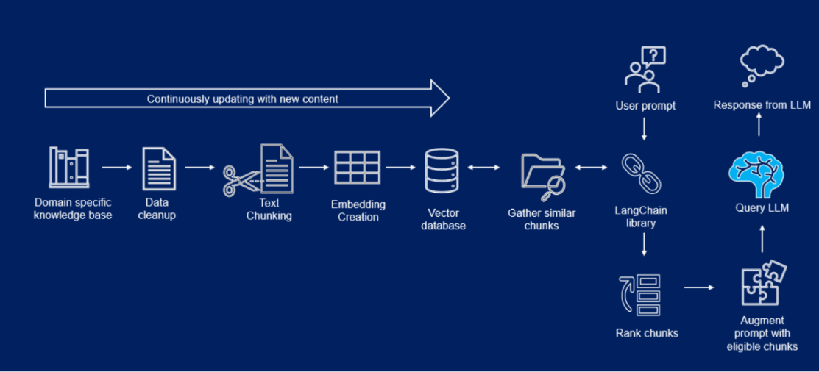
RAG Architecture: High-Level Overview
1. Document Ingestion: Load and preprocess documents
2. Chunking: Split documents into meaningful segments
3. Embedding: Convert text chunks to vector representations
4. Storage: Store embeddings in vector database
5. Retrieval: Find relevant documents for user query
6. Augmentation: Combine query with retrieved context
7. Generation: LLM produces response based on context

Slide 10
Step 1: Document Ingestion
Load documents from various sources (PDFs, web pages, databases)
Extract and clean text content
Preserve metadata (source, date, author, etc.)
Handle multiple formats: PDF, DOCX, HTML, Markdown
Common tools: PyPDF2, BeautifulSoup, python-docx, unstructured
Quality check: Remove duplicates, fix encoding issues

Slide 11
Step 2: Document Chunking Strategies
Why chunk? LLMs have context window limits (4K-128K tokens)
Fixed-size chunking: Simple but may break context
Semantic chunking: Split at natural boundaries (paragraphs, sections)
Recursive chunking: Hierarchical splitting for better context
Overlap: 50-200 tokens overlap prevents information loss
Typical chunk size: 500-1000 tokens balances context and precision

Slide 12
Chunking Best Practices
Do's
Maintain semantic coherence
Use overlap between chunks
Preserve paragraph boundaries
Include metadata in chunks
Test different chunk sizes
Don'ts
Split in middle of sentences
Make chunks too small (<200)
Ignore document structure
Lose source information
Use one-size-fits-all approach

Slide 13
Step 3: Vector Embeddings
Definition: Numerical representations that capture semantic meaning
Convert text to high-dimensional vectors (384-1536 dimensions)
Similar texts → Similar vectors (measured by cosine similarity)
Popular models: OpenAI embeddings, Sentence Transformers, Cohere
Key property: Semantic search possible (meaning-based, not keyword)
Example: 'ML techniques' matches 'machine learning methods'

Slide 14
Popular Embedding Models
OpenAI text-embedding-3-small: 1536 dims, high quality, API-based
all-MiniLM-L6-v2: 384 dims, fast, open-source, good for general use
all-mpnet-base-v2: 768 dims, balanced quality and speed
BGE (BAAI): State-of-the-art, multiple sizes available
Cohere embed: Multilingual support, API-based
Choose based on: accuracy needs, speed, cost, deployment constraints

Slide 15
Step 4: Vector Database Storage
Purpose: Efficiently store and search millions of vector embeddings
Key operation: k-NN (k-Nearest Neighbors) search
Popular options: Pinecone, Weaviate, FAISS, Chroma, Qdrant
FAISS: Facebook AI, fast, local deployment
Pinecone: Managed cloud service, scalable, easy to use
Weaviate: Open-source, combines graph + vector capabilities

Slide 16
Vector Database Selection Guide
Cloud-Managed
Pinecone: Easy, scalable
Weaviate Cloud: Managed option
Best for: Production at scale
Pros: No infrastructure mgmt
Cons: Ongoing costs
Self-Hosted
FAISS: Fast, proven
Chroma: Simple, embedded
Best for: Development, control
Pros: No recurring fees
Cons: Infrastructure needed

Slide 17
Step 5: Semantic Search & Retrieval
User query is converted to embedding (same model as documents)
Vector database finds most similar document embeddings
Returns top-k most relevant chunks (typically k=3-10)
Similarity measured by: Cosine similarity, Euclidean distance, or dot product
Advanced: Hybrid search combines semantic + keyword (BM25)
Re-ranking: Use cross-encoder to refine top results

Slide 18
Advanced Retrieval Techniques
Hybrid Search: Combine dense (semantic) + sparse (keyword) retrieval
Re-ranking: Cross-encoder models for better relevance scoring
Query Expansion: Expand query with synonyms, related terms
Metadata Filtering: Pre-filter by date, source, type before vector search
Parent Document Retrieval: Retrieve small chunks, return larger context
Hypothetical Document Embeddings (HyDE): Generate ideal answer, then search

Slide 19
Steps 6-7: Augmentation & Generation
Augmentation: Combine user query with retrieved documents
Prompt structure: System prompt + Context + User query
Example template: 'Given context: {docs}. Answer question: {query}'
Generation: LLM produces response based on provided context
Benefits: Grounded answers, reduced hallucinations, source attribution
Important: Instruct LLM to only use provided context, cite sources

Slide 20
Effective RAG Prompts
Clear instructions: 'Answer using only the provided context'
Handle missing info: 'If answer not in context, say I don't know'
Request citations: 'Include source references in your answer'
Format guidance: 'Provide answer in clear, concise paragraphs'
Example: 'You are a helpful assistant. Use the context below to answer...'
Test and iterate: Refine prompts based on response quality

Slide 21
Introduction to LangChain
Framework for Building LLM Applications

Slide 22
What is LangChain?
LangChain is an open source framework for building applications powered by large language models. It helps developers connect LLMs to external data sources, tools, and workflows. By providing abstractions for prompts, chains, memory, and retrieval, LangChain makes it easier to design, manage, and scale intelligent language based applications.

Slide 23
LangChain Core Components
Models: LLM wrappers (OpenAI, Claude, Llama, etc.)
Prompts: Template management and prompt engineering
Chains: Sequences of operations, composable workflows
Agents: LLMs that make decisions and use tools
Memory: Conversation history and state management
Callbacks: Logging, monitoring, and tracing

Slide 24
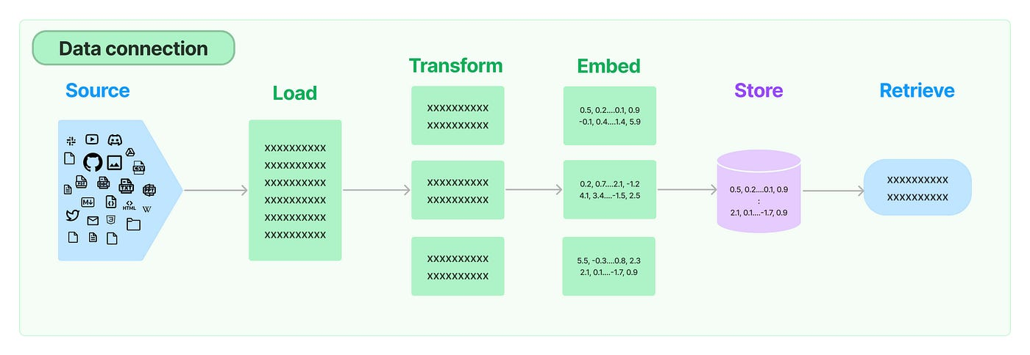
LangChain: Document Loaders
Purpose: Load documents from 100+ different sources
Common loaders: PDFLoader, CSVLoader, TextLoader, WebBaseLoader
Directory loaders: Process multiple files at once
API loaders: Notion, Google Drive, Confluence, GitHub
Database loaders: SQL, MongoDB, Elasticsearch
Example: PyPDFLoader for PDF files, UnstructuredHTMLLoader for web

Slide 25
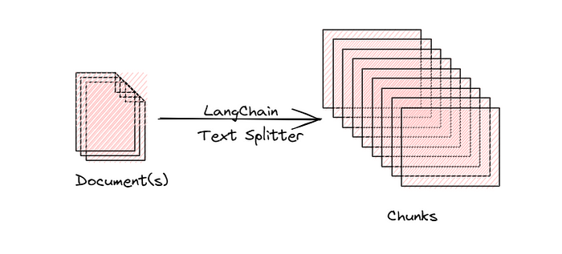
LangChain: Text Splitters
CharacterTextSplitter: Simple character-based splitting
RecursiveCharacterTextSplitter: Smart hierarchical splitting (recommended)
TokenTextSplitter: Split based on token count
MarkdownHeaderTextSplitter: Preserve markdown structure
Key parameters: chunk_size (max length), chunk_overlap (overlap amount)
Separators: Choose split points (["\n\n", "\n", " ", ""])

Slide 26
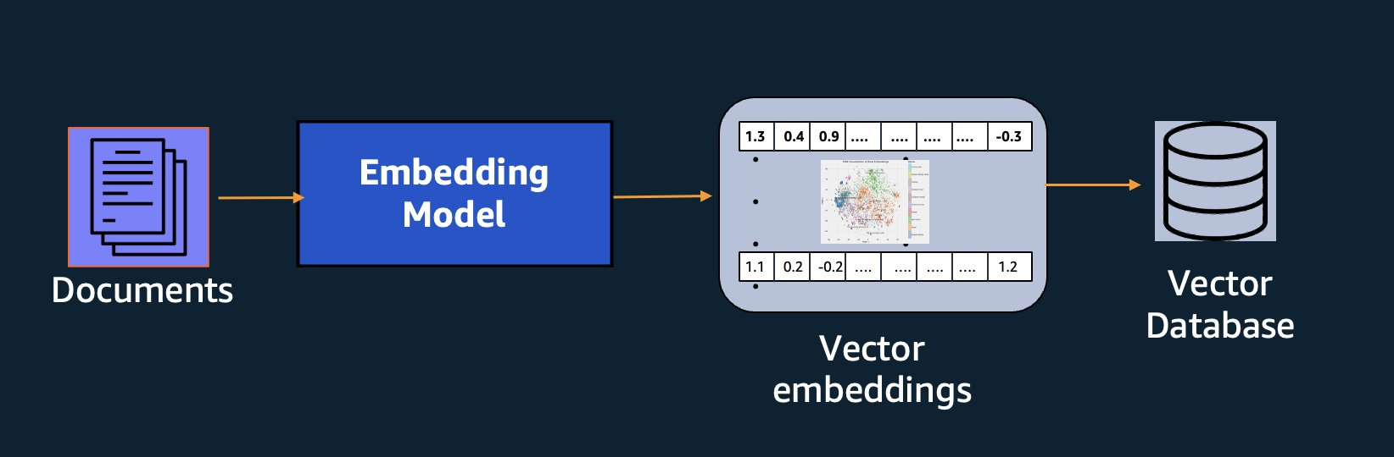
LangChain: Vector Store Integration
Unified interface for 50+ vector databases
Common methods: from_documents(), similarity_search(), as_retriever()
FAISS: Fast local development, .save_local() for persistence
Pinecone: Cloud-managed, requires API key
Chroma: Simple, persistent, good for prototypes
Example: Chroma.from_documents(documents, embeddings)

Slide 27
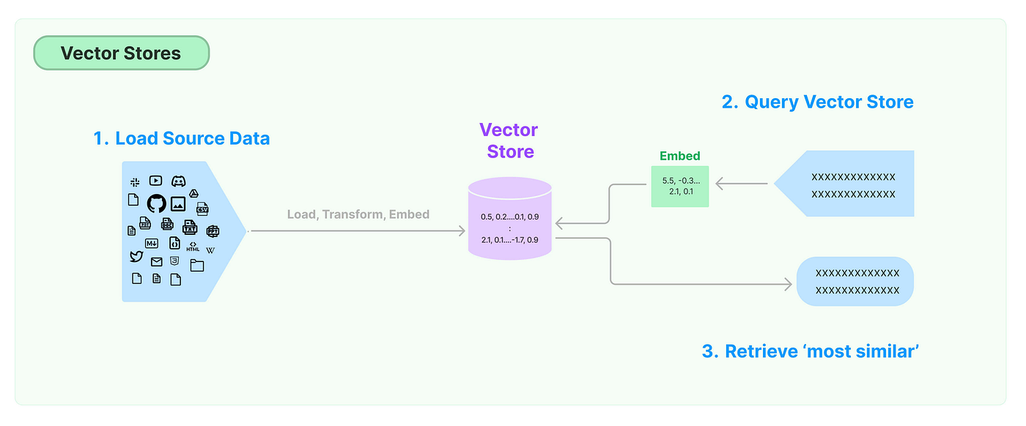
LangChain: Retrieval Chains
RetrievalQA: Simple question-answering over documents
Combines retriever + LLM in single chain
Types: stuff (concat docs), map_reduce, refine, map_rerank
'stuff' method: Simplest, puts all docs in one prompt
return_source_documents=True: Include sources in response
Example use: QA systems, documentation search, knowledge bases

Slide 28
Conversational Chains with Memory
ConversationalRetrievalChain: RAG + conversation history
Maintains context across multiple turns
Memory types: ConversationBufferMemory (full), ConversationSummaryMemory
Handles follow-up questions by reformulating with context
Example: 'What about price?' follows 'Tell me about product X'
Critical for chatbots and interactive applications

Slide 29
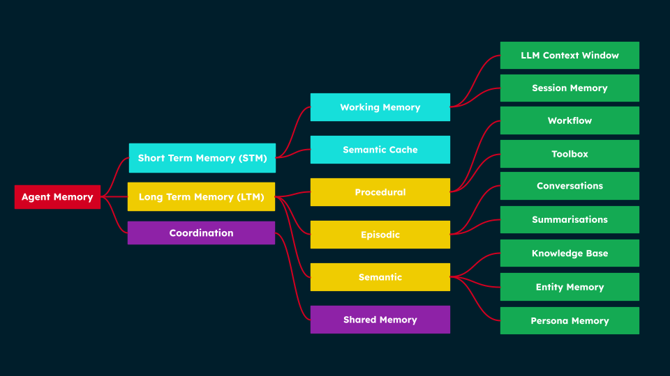
LangChain Memory Types
Short-term Memory
ConversationBufferMemory
Stores full conversation
Simple, exact recall
Limited by token window
Long-term Memory
ConversationSummaryMemory
Summarizes old messages
Scalable to long chats
VectorStoreMemory: Semantic

Slide 30
Building Production LLM Applications
From Prototype to Production

Slide 31
Production Architecture Layers
Frontend: User interface (Streamlit, React, Gradio)
API Layer: REST/GraphQL endpoints (FastAPI, Flask)
Application Logic: RAG chains, agents, orchestration
LLM Layer: Model providers, caching, load balancing
Data Layer: Vector DB, SQL database, caching (Redis)
Monitoring: Logging, metrics, error tracking, user feedback

Slide 32
Streamlit: Fast UI Development
Pure Python framework for data apps and chatbots
Built-in widgets: st.text_input(), st.button(), st.chat_message()
Session state: st.session_state for maintaining user data
Chat interface: st.chat_message() and st.chat_input()
Auto-reload on code changes during development
Perfect for: Prototypes, internal tools, demos, POCs

Slide 33
FastAPI: Modern API Framework
High-performance async Python framework
Automatic API documentation (Swagger/OpenAPI)
Type validation with Pydantic models
Async support for concurrent requests
Easy testing with built-in test client
Deploy with: Uvicorn (ASGI server), Docker, Kubernetes

Slide 34
Gradio: Interactive ML Demos
Create ML interfaces with few lines of code
Built-in components: Textbox, Chatbot, Image, Audio
Share via public link (gradio.live)
Integrate with Hugging Face Spaces for hosting
Perfect for: Model demos, stakeholder presentations, public sharing
Example: gr.Interface(fn=predict, inputs='text', outputs='text')

Slide 35
Choosing Your UI Framework
Streamlit
Fastest development
Python-only
Great for data apps
Built-in components
Best for: Internal tools
FastAPI + React
Full control
Scalable architecture
Separate frontend/backend
Professional UX
Best for: Production apps

Slide 36
Conversation Management Best Practices
Session Identification: Unique ID per user/conversation
Message Storage: Store in database (PostgreSQL, MongoDB) or cache (Redis)
Context Window Management: Limit messages to fit LLM context
Message Summarization: Summarize old messages when window fills
Metadata Tracking: User info, timestamps, ratings, feedback
State Management: Track conversation stage, user preferences

Slide 37
Production Deployment Best Practices
Error Handling: Graceful degradation, user-friendly error messages
Rate Limiting: Prevent abuse, manage API costs
Caching: Cache frequent queries, embeddings, LLM responses
Monitoring: Log all interactions, track latency, error rates
Security: Input validation, SQL injection prevention, API key rotation
Cost Management: Token tracking, budget alerts, usage quotas

Slide 38
Monitoring LLM Applications
Metrics to track: Latency, token usage, error rate, user satisfaction
Tools: Langsmith, Weights & Biases, Prometheus, Grafana
User feedback: Thumbs up/down, ratings, comments
A/B testing: Compare different prompts, models, RAG strategies
Cost tracking: Monitor API costs per user, per query
Quality assurance: Regular evaluation on test sets

Slide 39
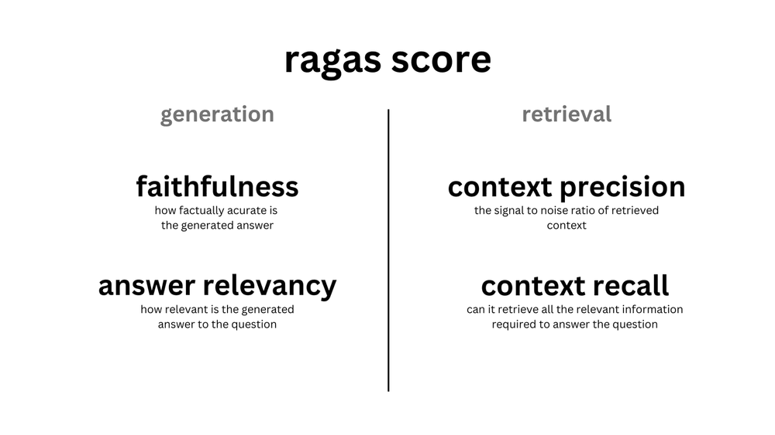
Evaluating RAG Systems
Evaluating retrieval augmented generation systems focuses on both retrieval quality and generation quality. Key aspects include how relevant and accurate the retrieved documents are, how well the model uses the retrieved context, and whether the final response is correct, complete, and grounded in the source data. Effective evaluation helps identify weaknesses in retrieval, prompt design, or model behavior, leading to more reliable and trustworthy LLM applications.
Retrieval Metrics
Precision@K
Recall@K
MRR (Mean Reciprocal Rank)
NDCG
Hit Rate
Generation Metrics
Faithfulness
Answer Relevancy
Context Precision
RAGAS Framework
Human Evaluation

Slide 40
Common RAG Pitfalls & Solutions
Chunk size issues: Test different sizes, use overlap
Wrong embedding model: Match domain, benchmark options
Ignoring metadata: Use for filtering, source attribution
Poor prompt engineering: Iterate, test, refine prompts
No context window management: Track tokens, summarize when needed
Lack of evaluation: Implement metrics, gather user feedback

Slide 41
Key Takeaways
RAG enhances LLMs with external, verifiable, up-to-date knowledge
Proper chunking, embeddings, and retrieval are critical for quality
LangChain simplifies building complex LLM applications
Multiple UI frameworks available: Choose based on requirements
Production requires: Architecture, monitoring, testing, user feedback
Iterate continuously: Evaluate, gather feedback, improve
Combine RAG and fine-tuning for optimal performance

